Slide 1
Policy
Assessments
Curriculum
PD
Program Coherence Health Check
Are we well-aligned?
Notes:
March 2017 Release
Setting the scene
(5 minutes)
You may like to customize this slide and/or the last one with your own institutional and contact details.
Please leave the copyright attribution, however.
Possible comments below are in plain text.
Suggestions are in italics
Today’s meeting is about engaging in a conversation on the coherence within the district mathematics’ program;
asking ourselves if the various aspects of the districts’ program are well-aligned?
Investigating this is our goal in this workshop.
Copying
Except where noted/credited otherwise, these materials are Copyright © 2015-2017 Mathematics Assessment Resource Service, University of Nottingham. They are published under the Creative Commons Attribution-NonCommercial-ShareAlike 4.0 International license, so they may be copied and adapted for non-commercial use under certain conditions and with appropriate attribution. Please see the license for details, or contact us via http://mathnic.mathshell.org/contact.html if in doubt.
All MathNIC materials can be freely downloaded from our website http://mathnic.mathshell.org/

Slide 2
Workshop Outline
What is program coherence?
Key diagnostic probe: the range of task types
Expert, Apprentice and Novice Tasks
Looking at our program
Different kinds of math challenge
What have we learned? - a forward look
Notes:
Move through the first 10 slides fairly quickly
Posted here, is an outline of what we are going to work through today in our effort to make sense of the coherence of current district (school) mathematics programs.
Rough timing
What is program coherence? 5 minutes
Key diagnostic probe: the range of task types 5 minutes
Expert, Apprentice and Novice Tasks 25 minutes
Looking at our program 30 minutes don’t get here late
Different kinds of math challenge 10 minutes
What have we learned? - a forward look 10 minutes

Slide 3
What is program coherence?
A coherent mathematics program:
is a focused, logical, clearly articulated set of concepts and skills
with connections to each other and to applications in a variety of contexts from the real world and within mathematics.
is uniform across buildings and the district providing all students the opportunity to learn important mathematics
is supported by all aspects of the districts program.
Notes:
This slide explains what we mean here by program coherence.
Read the slideslowly

Slide 4
What are the key “drivers”?
We send messages to math teachers through:
  policy statements
  curriculum materials
  District Assessments
  professional development OFFERINGS
Are they consistent and coherent?
Notes:
When determining if a district program is coherent, one needs to consider the various elements that drive the program.
All programs in schools are comprised of policy statements, curriculum materials, assessments, the actual instruction that takes place in classrooms, and professional development offerings the educators are asked to attend.
To guide teachers in their instruction within classrooms, one needs to ask-- are the messages to teachers, across these domains, consistent and aligned?
For example, it is so easy for poor high-stakes assessment to undermine the intentions of our policy statements and curriculum materials and thus the instruction in the classroom.
If any element is out of line, the whole program can fail.

Slide 5
Success in Mathematics
“Proficient students expect mathematics to make sense. They take an active stance in solving mathematical problems. When faced with a non-routine problem, they have the courage to plunge in and try something, and they have the procedural and conceptual tools to carry through. They are experimenters and inventors, and can adapt known strategies to new problems. They think strategically.”
Notes:
How would you describe the underlying purpose and goals of your school mathematics programs? The statement posted, from the Common Core State Standards draft, reflects the beliefs, purpose and goals found in high-performing countries, per PISA, and the mathematical needs of society for the 21st century.
As you read the slide, ask yourself:
Is this what all of us in our district are working towards?
(The quote is taken from a draft of the common core document)

Slide 6

Key diagnostic probe:
The range of task types
Notes:
Key diagnostic probe
(5 Minutes starting at ~5 minutes)
A powerful probe one can use to think about the coherence within a program is to review and analyze the variety of types of task that students are asked to tackle.
This strategy is based on examining the types of task in the program's curriculum materials and assessments.
If students spend most of their time doing low-level tasks, their achievement will be low level. The key to higher standards, and better mathematics programs, is improving the tasks that students work on most of the time.
Tasks are key indicators of coherence – they are the canary in the coal mine.

Slide 7
Tasks are central to:
Defining the curriculum
Focusing the teaching and learning
Making sure important mathematics is assessed
Making policy meaningful
Notes:
Coherence means having the right kinds of tasks in the assessments, the curriculum materials and the PD offerings; tasks that together create a balanced mathematical experience for students and teachers. It also means having policies that support ALL students in ALL classes using a balanced set of curriculum materials and receiving instruction with a range of task types.
Basically, by reviewing and analyzing tasks, one can get a better understanding of how policy, assessments, curriculum materials and PD offerings, link together and the kind of coherent, or incoherent, message that is being sent by the district.

Slide 8
Progression?
In Language Arts:
Progress lies in the ability to read and compose
increasingly complex texts in
increasingly sophisticated ways
In Mathematics:
Progress lies in the ability to tackle, and investigate
increasingly complex tasks in
increasingly sophisticated ways
Notes:
A coherent program is not only a focused and clear set of concepts, skills and strategies to be developed over time, but it also progresses in complexity.
In English Language Arts progression is measured by the student’s ability to deal with increasingly complex texts, in increasingly sophisticated ways.
In high-quality Mathematics curricula it is similar but with tasks instead of texts
(Read the “In Mathematics” paragraph)
This may be a different way of looking at progression in math. It's not just moving on from arithmetic to algebra but also the complexity of the situations in which one needs to use mathematics to solve problems.
This holistic view is standard in ELA – and in mathematics outside school.

Slide 9
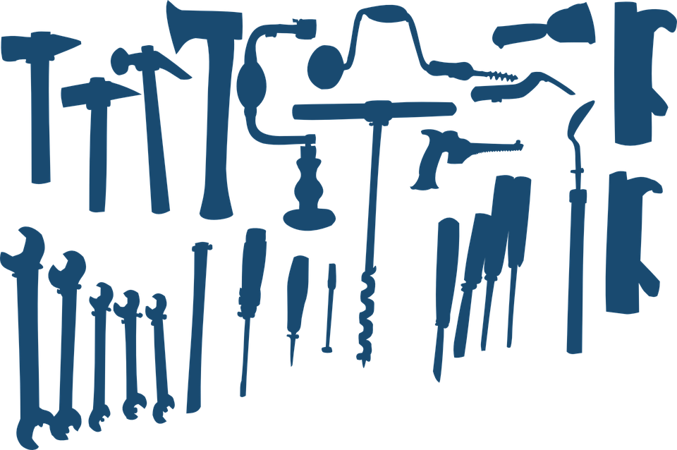

Doing mathematics involves…...
Content:
concepts and skills
  Building a toolkit of knowledge and techniques and making connected sense of it
Practices:
problem solving and reasoning:
  Selecting and using appropriate tools to tackle problems that arise, in math and in the world beyond the classroom
  Explaining one’s reasoning and conclusions
Notes:
Thus, coherent mathematics programs involve learning mathematical content but also, and equally important, being able to use the content to solve problems.
As you read the slide, note the two aspects
Learning concepts and skills is like building a toolkit. This is, of course, vitally important…
.. but students also need to learn how to select from and use these tools to tackle problems from within mathematics and from the real world.
This is what high standards are all about.
It’s no good building up a really sophisticated toolkit and set of skills, if you cannot use them to make anything.

Slide 10
Because ….
Content and Practices
need
different types of task
Notes:
Read the slide slowly with emphasis
The point being—one needs different kinds, different types of task to assure that one has a coherent, balanced program that is preparing students to be the “proficient student” for whom
mathematics makes sense and who can take an
active approachin solving problems that require mathematics.
A program that includes students doing tasks that show their knowledge of the content but also tasks that show they can use the components in their mathematical tool kit to solve problems and reason.

Slide 11
Expert, Apprentice and Novice Tasks
Some examples
Notes:
Expert, Apprentice and Novice Tasks
(25 minutes starting after ~ 10 minutes)
Including time for discussion of the problem on Slide 18: Airport Turnround
What do we mean by "types of task"?
It is useful to distinguish three very different types of task: Expert, Apprentice and Novice
Descriptions of each type are given in Handout 1 – it’s not needed right now but will be given out later.
First, let's see some examples of each type.
Later we’ll analyze each kind and how they differ.

Slide 12

Novice tasks
14 X 32 =
Find the area of
Factor the expression: x² + 3x – 4
Write sin(A+B) in terms of:
sin A, cos A, sin B and cos B
Notes:
Move through the 5 novice task slides fairly quickly, pausing on those that best fit the math level of the participants
We'll start with some novice tasks, because these are most familiar in school math.
Each task involves a standard routine procedure –
one that students have been taught and, hopefully, learned.
Even though the techniques become more complex, these are all imitative: novice tasks.
Tasks of this type are also referred to as “low-level” tasks in the literature - though they can, of course, be difficult.
Pause for a moment, then move on.

Slide 13
A Novice Task
A rectangular fenced in dog pen has sides of 3 feet, 6 feet, 3 feet, and 6 feet. How many feet of fencing make up the dog pen?
Notes:
Here's another one for elementary school - a novice task on perimeter.
Even though there are “words” in this problem, this is still a novice task as it is just using the perimeter definition and a learned procedure for calculating it. .

Slide 14
A Novice Task
Some Novice tasks
These three graphs show the functions:
y = x²
y = x² + k
y = k x²
Where: k > 1
Label the three graphs
Notes:
Optional slide. If participants do not include high school mathematics teachers consider not using this slide.
Quick slide
Here's another one - about graphs of functions
Only short chains of reasoning are required, only a few steps – a key feature of novice tasks.
So which graph is which function?
Ask for suggestions, then
Can you explain why?

Slide 15
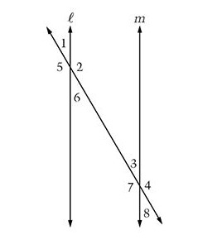
A Novice Task
In the figure to the right, line l is parallel to line m. Which of the following pairs of angles must have the same measure?
A. Angles 1 and 2
B. Angles 1 and 5
C. Angles 2 and 3
D. Angles 4 and 5
E. Angles 4 and 8
Notes:
Here's one for middle school
Often the easiest way to solve a multiple choice task is by elimination.
That can lead to "test prep" time that improves test scores but not the students' math.

Slide 16
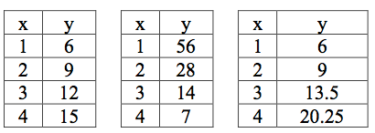
A Novice Task
Some Novice tasks
One of these tables represents a linear relationship, one an exponential growth and one an exponential decay. Label each table correctly.
Notes:
Optional if participants do not include middle or high school math teachers.
Another multiple choice example
Explanation paragraph optional – for more mathematical groups
Here the concepts of linearity, growth and decay are enough to solve this task.
Linear means equal steps in x mean equal steps in y – as in the first one
Of the other two one increases – growth – the other goes down –decays
You don’t actually need to understand exponentials: equal steps in x mean equal ratios in y
Now lets look at some expert tasks

Slide 17
Expert tasks
So what do we mean by “expert tasks”?
Problems, not predigested, but as they arise:
  in the world outside the math class
  in really doing mathematics
Problems in which a taught method and a single skill is not sufficient to complete the task – you have to work out what to do.
Let’s look at a few examples
Notes:
What is an expert task?
Read the bullet point paragraph
Because expert tasks are less familiar in school math, let’s look at a few examples - for middle school.
Expert tasks, like essay topics, are asking students to put together multiple ideas and use them in complex situations.
These tasks are less grade specific, allowing students to respond at their level.
They reveal to educators what tools from their toolkit of concepts and skills students can actually use in problem solving and reasoning.
The tasks being shown are from high-stakes tests, not commonly used in then US, but used regularly in other countries’ tests.

Slide 18
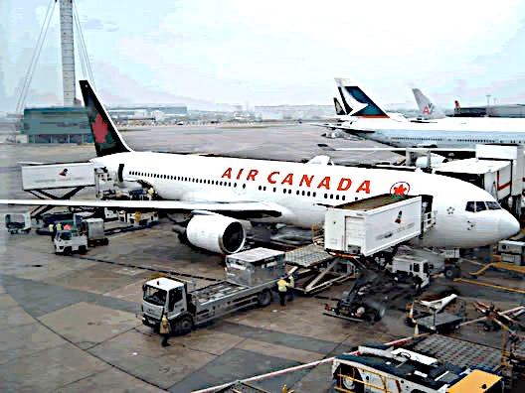
An Expert Task
Airplane Turn-round
Between landing and taking off,
these jobs all need to be done.
How quickly can it be done?
 | Job | Time needed
A | Get passengers out of the cabin and off the plane | 10 minutes
B | Clean the cabin | 20 minutes
C | Refuel the plane | 40 minutes
D | Unload the baggage from the cargo hold | 25 minutes
E | Get new passengers on the plane | 25 minutes
F | Load the baggage into the cargo hold | 35 minutes
G | Do a final safety check before lift-off | 5 minutes
Notes:
Take time for discussion on this slide
Airplane Turn-round is quite demanding even though the necessary content is just simple arithmetic.
Guess what the kids tend to do? If no response
Yes, they just add the numbers. That’s school math
But when you ask “Is there a quicker way?”, they soon get to talk about what things can be done in parallel.
You might like to talk with your neighbor about how you might approach solving it.
Allow a few minutes for pairs to discuss, then
What did you find? Other ideas?
Take suggestions without comment.
[The shortest turnaround time is 65 minutes = (D+F+G)]
That’s a brief taste of what it means to engage with an expert task.

Slide 19
An Expert Task
Traffic Jam
Traffic has come to a stop. The line is 12 miles long on a two-lane freeway.
How many cars are in the traffic jam?
Drivers have a two-second reaction time. When the accident was cleared, how long for the last car to move?
Notes:
Quick slide Just talk this through
Traffic Jam is another nice example of an expert task. The problem relates to everyday life.
Read the slide
The necessary content is ratio and proportion with some knowledge of units.
What makes it more demanding is that you have to identify the relevant data that is needed
(things like average vehicle length, gaps between vehicles, proportions of different vehicles),
make assumptions as to their value, formulate the appropriate division calculation, and
interpret the result.
In part 2, it's reaction time times the number of cars.

Slide 20
An Expert Task
Counting Trees
The diagram shows some trees in a tree farm.
The circles show old trees
The triangles show young trees.
  Think of a method you could use to estimate the number of trees of each type. Explain the method fully.
  Use your method to estimate the number of old trees and young trees.
Notes:
Quick slide Just talk this through
Here’s another nice example
Read the slide.
Counting Trees involves coming up with a strategy for sampling that
incorporates the relevant facts, and
is represented in a suitable way,
Students need to make clear the assumptions they have made and the effect these assumptions have on the answer.
These three expert tasks show something of the nature of mathematical expertise, described in the Mathematical Practices.

Slide 21
Apprentice tasks
Expert tasks with added scaffolding to:
  ease entry
  reduce strategic demand
Ramp of difficulty within the task, with increasing:
  complexity
  abstraction
  demand for explanation
A step in growing expertise:
“climbing with a guide”
Notes:
Read the slide
Look at Handout 2: 'Multiplying cells'
Talk it through it with you neighbor.
Leave a minute or two for this
Notice how specific design tactics are used, “scaffolding” the essential task into a sequence of prompts.
• The diagrams, and the number of cells by counting, ease the entry to the problem.
• The structuring into parts reduce the strategic demand.
• Providing the table directs the representation aspect.
•There is a steady increase in difficulty through 1-5.
Having a lot of experience with apprentice tasks like this helps students develop the habits of expertise they need to use autonomously, without “the guide”, in tackling expert tasks.

Slide 22
An Apprentice Task
I have some pennies, nickels, and dimes in my pocket. I pull out three of the coins and keep them in my hand.
How much money do you think I have in my hand? Find as many different amounts as you can think of and list on your paper.
Could I have 11¢? How, or why not?
Could I have 4¢? How, or why not?
Notes:
Option: if the Cells task seems too advanced for elementary school folk, this or the following slide could be used for discussion instead of Handout 2
Here's an apprentice task for elementary school

Slide 23
An Apprentice Task
A friend asks you to help them build a rectangular pen for her dog. You have 24 feet of fencing that comes in 1 foot sections.
Find all the different rectangles you could build. Sketch each one on grid paper.
Which pen gives the dog the most space to play? Which one gives the dog the least amount of space to play?
Which would you make for the dog? Why?
Notes:
Here's an apprentice task based on elementary school or middle school math - depending on which method a student decides to use.

Slide 24
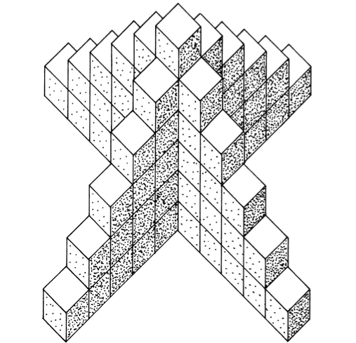
An Apprentice Task
Skeleton Towers
How many cubes do you need to make a tower like this:
  6 cubes high?
  20 cubes high?
  n cubes high?
Explain your reasoning
Can you find another method?
Notes:
An option at middle or high school math level
Scaffolding can be more subtle than in Patchwork.
In Skeleton Towers
6 cubes high can be worked out by counting
20 cubes high invites a solution based on a pattern like 1 + 5 + 9 + 13 + …. + 77
Or 20 + 4(19+18+ ….+1)
n cubes high invites a complete generalization: n(2n-1). This may be obtained by various means, algebraic or geometric.
Without the first two prompts, this would be an expert task
If you have plenty of time, and a group interested in math, you may like to discuss different possible solution approaches.
Perhaps the simplest solution is to break off two opposite legs,
turn them upside down on the other two - and so make a rectangle n high by 2n-1 wide

Slide 25
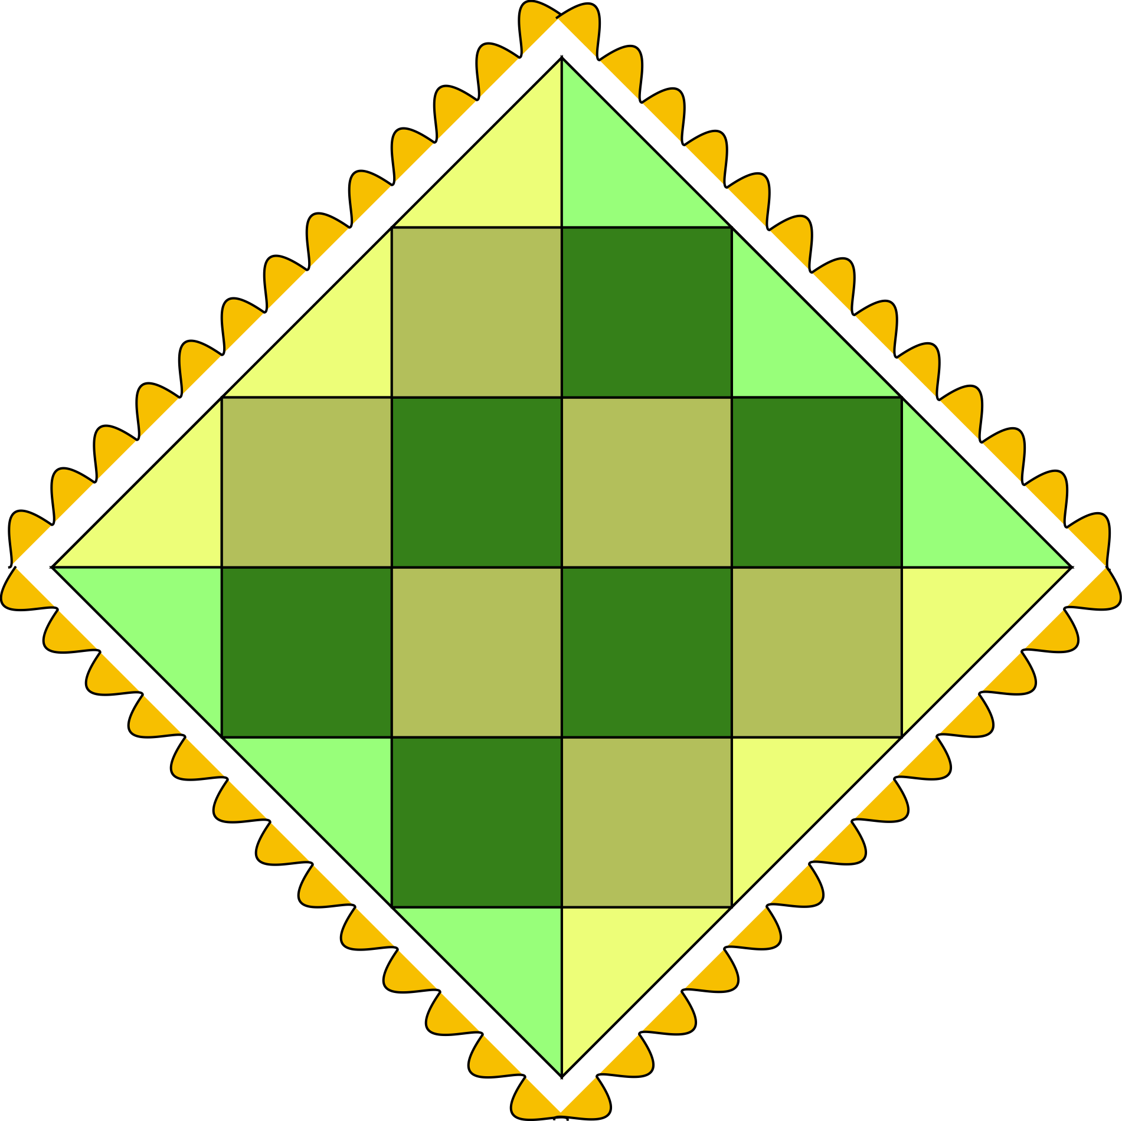
Expert, Apprentice or Novice Task?
Compare the sources of difficulty:
  Complexity?
  Understanding what the task involves
  Unfamiliarity?
  Working out strategy and tactics
  Technical demand?
  Selecting the tools to use
  Autonomy expected?
  Length of the chain of reasoning?
If you are a math person, estimate the grade at which students
  Could make some progress
  Provide a complete solution
Notes:
Now let's compare the three tasks in Handout 3.
The three have the same underlying math but present very different kinds of challenges.
Discuss with your neighbor what are the kinds of difficulty in each task.
Decide, for each version, if you think they are a novice, apprentice or expert task.
Allow at least 5 minutes, then collect comments. Summarize (or reflect) as follows.
Patchwork Version 1 is a task in a situation that might well arise.
You have to work out the strategy and do the whole thing, formulating the rules. This strongly involves the mathematical practices.
It’s an Expert task.
Version 2 gives a formula, asks students to apply it, then solve an inverse problem.
This is a routine exercise. It’s a Novice task.
Version 3 breaks the task in Version 1 into a series of guided steps.
It’s an Apprentice Task.

Slide 26
Looking at our program
Notes:
Looking at our program (30 minutes starting after ~35 minutes)
This section is the heart of the workshop – feel free to extend it if there is more time.
Now we’re going to use this same “task review and analyze” approach to look at and classify the messages we send to our teachers and students:
first – through curriculum;
then – through assessment.
At this time, we will not be examining professional development offerings or district policies – but focus on discussion of the evidence from two components of our program, and the implications.

Slide 27
Mathematical practices = expert tasks
“Proficient students expect mathematics to make sense. They take an active stance in solving mathematical problems. When faced with a non-routine problem, they have the courage to plunge in and try something, and they have the procedural and conceptual tools to carry through. They are experimenters and inventors, and can adapt known strategies to new problems. They think strategically.”
Notes:
Just a reminder of this summary of the goals of mathematics education.
Point again to a few key phrases: make sense, plunge in and try, carry through procedures, think strategically.
Now let’s look at our system.

Slide 28
Does our curriculum develop expertise?
Handout 4 is a sample of the tasks in the curriculum our students go through.
We have labeled each task E, A or N
Take a few minutes to review our classifications with your neighbor.
The core questions:
What is the balance across E, A and N?
Is it reasonable?
Notes:
Say which grade the materials are from
Add that the sample is probably fairly typical across grades – if you think so
Give them plenty of time to look through the tasks and consider your labels E, A and N
Discuss any questions. Then:
Now to core questions:
What is the balance?
Is it reasonable?
Go straight to next slide

Slide 29
A balanced diet?
We have looked at our curriculum and estimated the proportions of classroom time that our students spend on Expert, Apprentice and Novice tasks. The numbers are at the end of the Tasks Handout
Are these proportions all substantial?
Are they what we want?
Does the curriculum support teaching for expertise?
Could teachers ignore teaching for expertise?
Notes:
As you make the sample for Handout 4, estimate the proportions across the year’s curriculum
These are numbers for you to enter on the Handout (and the slide if you can revise it! See Preparation)
You will see at the end of the Handout that the times students spend in our curriculum are approximately
Expert xx% , Apprentice yy%, Novice zz%
Explain the last 2 points more fully
The teaching for expertise that the Common Core requires is more demanding on teachers, and includes aspects that are new to many.
Will they think that they can afford to ignore this amount and just continue with novice math?

Slide 30
Do our tests support expertise?
Handout 5 is a sample of the tasks in the by which we judge our students and teachers.
We have labeled each task E, A or N
Take a few minutes to review our classifications with your neighbor.
Again, the core questions:
What is the balance across E, A and N?
Is it reasonable?
Notes:
Read the slide
This activity should replicate that for curriculum in the last two slides, but now with Handout 5.
Again, say which grade the materials are from
Add that the sample is probably fairly typical across grades – if you think so
Give them plenty of time to look through the tasks and consider your labels E, A and N
Discuss any questions.
Again, the core questions
Go straight to next slide

Slide 31
Are our assessments balanced?
We have looked at our curriculum and estimated the proportions of classroom time that our students spend on Expert, Apprentice and Novice tasks. The numbers are at the end of the Tasks Handout
Are these proportions all substantial?
Are they what we want?
Do the tests encourage teaching for expertise?
Could teachers ignore teaching for expertise?
Notes:
As you make the sample for Handout 5, estimate the proportions of time across the year’s assessments
These are numbers for you to enter on the Handout (and the slide if you can revise it!)
You will see at the end of the Handout that the times students spend in our assessments are approximately
Expert xx%
Apprentice yy%
Novice zz%
Encourage participants to discuss the questions on the slide be sure to ask the last question—
What has been shared with you is a rough estimate of what we found when we looked at the curriculum materials and district assessments.
Are you happy with the “coherence” presented in these two domains of our program?
Do they reflect the same message that we have sent to teachers and principals through:
our professional development offerings and
district policies?
Will teachers and principals think that they can and should continue with only novice tasks– because it won’t reduce their students' scores on these tests by much?

Slide 32
Different task types, different roles
Content:
Concepts and skills can be taught through novice tasks
Consolidating understanding needs connections = more complex tasks, apprentice and expert
Mathematical practices:
Problem solving and reasoning can only be developed through working on expert tasks
Notes:
As you continue to think and reflect on the district program, lets think about why is it important to have these different types of task.
Each of these task types has a different role.
Note the two aspects of knowing mathematics:
Learning concepts and skills is like building a toolkit. This is of course vitally important…
.. but students also need to learn how to select and use these tools to tackle problems from within mathematics and from the real world.
This is what problem solving and reasoning, and the mathematical practices, are all about.
It’s no good building up a really sophisticated toolkit, if we never use them to make anything.
Let's look at this in a bit more detail

Slide 33
Different kinds of math challenge
Notes:
What makes a math task difficult? (10 minutes starting at ~65 minutes)
What makes a task difficult?
This is a key issue.
We are used to thinking it is just "harder math", more advanced content. But with the broader range of task-types that high standards involve, that is far from true.
Let's look at it.

Slide 34
Tasks become more difficult as you increase:
Complexity
  Are there many variables, complex information, messy situations?
Technical demand
  Are challenging concepts and skills involved?
Unfamiliarity
  Have students met tasks just like this before?
Autonomy expected
  Are long chains of umprompted reasoning involved?
Notes:
This is fairly obvious
• If a task is made more complex, it gets harder.
• If it needs advanced content, it’s harder – we’ve always known that and, perhaps, only that.
• If you’ve been taught how to do one very like it, it’s easier.
• Constructing a long chain of reasoning is harder than responding to a scaffolded sequence of prompts, or short items.
But, though all this is obvious, it has profound implications because
the Standards, like the 21st century world, value problem solving and reasoning.
This means students tackling complex, non-routine tasks
Solving them demands long chains of reasoning.

Slide 35

Different demands – Similar difficulty
Task 1
Task 2
For two tasks with comparable ‘cognitive load’, one that is more demanding in some aspects must be less so in others
Notes:
Read the sentence below the diagram
This means that complex, non-routine tasks should not require recently-learned content.
Such tasks - the right side of the balance - complement technical exercises on grade level content (the left side)
Mathematical literacy, which is what PISA assesses, is
“The sophisticated use of [relatively] elementary mathematics”
Quote from Lynn Steen in "Mathematics and Democracy"

Slide 36
Novice Apprentice Expert
Complexity
Technique
Unfamiliarity
Autonomy
Complexity
Technique
Unfamiliarity
Autonomy
Complexity
Technique
Unfamiliarity
Autonomy
Short items – skill focused Up to grade skills and concepts | Scaffolded tasks Ramped level of demand | Realistic tasks from real world or ‘real math’ Well- absorbed skills and concepts – many from earlier grades
Liitle from Mathematical Practices | Modestly involve Mathematical Practices | Strongly involve Mathematical Practices
Notes:
It is useful to summarize these differences and distinguish between Novice tasks, Apprentice tasks and Expert tasks.
The balance of different kinds of difficulty are shown, in this very schematic diagram, by the font sizes.
point to diagram
Moving from left to right
Complexity, unfamiliarity, and student autonomy increase - along with the need for skill in the mathematical practices
Technical demand has to decrease to maintain the level of difficulty
Handout 1 summarizes these things – for later reading

Slide 37
What have we learned?
Notes:
What have we learned? (10 minutes starting at ~75 minutes, mostly discussion and planning for next steps)
This session has been about diagnosis – learning what our current program is like on coherence.
It has given us all something to think about.
What are your initial impressions?
Let people make their points but limit the time, moving on to the next slide

Slide 38
Discussion points
Context
Many US classrooms have just taught “novice math” – reflecting the short-item tests on which success has been judged. New tests are better.
Teaching math for expertise is harder, requiring teachers to gain “adaptive expertise” – the ability to modify one’s lesson to build on students’ responses.
Action
If our assessment and curriculum are balanced across E, A and N tasks: fine – we can focus on developing teachers’ expertise – otherwise,…
Notes:
Obviously there is a lot to talk through another time
But before we finish, let’s look forward
Read the slide
Given this context, and where do we think we are?
Let's begin to think about strategies for improvement - clearly something to follow up on if we think it's needed.

Slide 39
Strategies for improvement
If our testing or our curriculum or both
lack substantial components focused on
expert and apprentice tasks, we need to consider how we could improve them – now or, better, gradually
• The MathNIC workshop on
“Ways of improving program coherence”
offers a structured discussion of various options for
Improving coherence of curriculum and/or tests
Either way, for success, …..
Notes:
Read the first bullet
The right balance of task-types is not sufficient to guarantee coherence (a teacher could teach the students how to tackle an expert task, for example, reducing it to a sequence of novice tasks)
but it is a necessary condition, an essential opportunity to learn, and to perform
The Mathematics Improvement Network has developed a follow up workshop session
through which we can review ways to improve coherence.
Shall we move to schedule that?

Slide 40
Ongoing professional development
It is a truism that teacher expertise is the key to improvement in any education program
The Common Core (~ international standards) raises the bar for teachers as well as students
So teacher PD is a key component in making any progress in what happens in classrooms
Not all types of PD produce changes in teachers teaching.
The MathNIC workshop on
“Designing Professional Development”
will take us through a range of issues and options.
Notes:
We have not looked at professional development - one of the four areas over which coherence is important that we set out at the beginning.
Read the slide
In this district we have a lot of experience and some well-established professional development.
But it's expensive and we don't always see the changes we would like in our classroom visits afterwards.
This MathNIC workshop is about issues in design of PD. Would we like to look at that?

Slide 41
Thank you
< insert contact details >
Notes:
Insert your contact details on this slide.

