Slide 1
World Class Mathematics for Parents: What is it and what does it mean for my child?
Notes:
March 2017 Release
You may like to customize this slide and/or the last one with your own institutional and contact details.
Please leave the copyright attribution, however.
Possible comments below are in plain text. Suggestions are in italics.
Users will, of course, adapt as necessary – though we recommend sticking with this activity sequence the first time or two.
The purpose and goals for this session are to provide more information on the district’s mathematics program and
your child’s learning experiences in math classrooms.
I am sure there are questions you have in mind.
We’ll try to answer some of them in the next hour or so, with a Q&A at the end for the others.
Move fairly quickly through Slides 1 to 7
Copying
Except where noted/credited otherwise, these materials are Copyright © 2015-2017 Mathematics Assessment Resource Service, University of Nottingham. They are published under the Creative Commons Attribution-NonCommercial-ShareAlike 4.0 International license, so they may be copied and adapted for non-commercial use under certain conditions and with appropriate attribution. Please see the license for details, or contact us via http://mathnic.mathshell.org/contact.html if in doubt.
All MathNIC materials can be freely downloaded from our website http://mathnic.mathshell.org/

Slide 2
Outline
Standards: Why and what?
Tackling a real problem
Your priorities as parents
Concepts and skills
Concepts and Skills support Problem Solving
Q & A
Notes:
This is how the workshop should go
Read the slide

Slide 3
Key Questions
What are standards? Standards are learning expectations for students.
Why do we need new standards?
What do they mean for a district’s mathematics program?
We will explore these questions in this session
Notes:
Introduction (10 minutes)
Our aim in this session is to give you a picture of the State Standards for Mathematics,
what they mean in terms of learning, and the important skills your children will develop.
From some of the things you have heard, you may be surprised to know that, in the new Standards,
students still learn the basic skills and concepts, such as arithmetic and algebra! 2 + 2 still makes 4!
But they also learn something more – how to think with mathematics.

Slide 4
Why have new Standards?
Concern with:
disparate standards across states
student mobility
global competition
today’s jobs require different skills
Governors and state superintendents pushed for the development of common core standards for grades K-12 in ELA and Mathematics
Gates Foundation supported the development, involving wide consultation. They were released in 2010.
Notes:
Optional slide
First a word about the history.
The need for new, higher Standards grew from various things
Read the slide
What we know from research and from employers is that people need to learn to be able to use their math
- to construct chains of reasoning from a problem situation through to a solution.

Slide 5
Why have new Standards?
“Talk to business leaders or university presidents or tech CEOs, and they'll say that
today's graduates need to be able to
solve real-world problems and
engage in sophisticated forms of math thinking,
not just memorize math facts.”
Boser, U., U.S. News and World report, November 4, 2015
Notes:
This article from U.S. News and World report summarizes the need for new standards in a sentence
Read the slide
Now let's look at the Standards in a bit more detail

Slide 6
Mathematics Content Standards
Main focus:
Students in K-5 develop a solid foundation in basic conceptual understandings and procedures (with a heavy focus on number and computation)
In the middle grades, students build on this foundation through hands on learning in geometry, algebra, probability and statistics (with an focus on proportionality)
High school students study advanced mathematics and apply mathematical ways of thinking to real world challenges (emphasizing mathematical modeling)
Notes:
There are the Mathematics Contents Standards
These form the bulk of the Standards document and describe the concepts and skills that should be taught.
Much of what is here could be found in past individual state standards.

Slide 7
Mathematical Practice Standards
Make sense of problems and persevere in solving them.
Reason abstractly and quantitatively.
Construct viable arguments and critique the reasoning of others.
Model with mathematics.
Use appropriate tools strategically.
Attend to precision.
Look for and make use of structure.
Look for and express regularity in repeated reasoning.
Notes:
The Mathematical Practices are the main new feature of the standards.
Handout 1, for reading later, expands on what they mean.
They describe what really doing mathematics involves – so they have always been there, implicitly, but have often been neglected.
The practices clarify the depth of understanding that students need to have.
They emphasize that understanding a mathematical topic means students can use the concept to
make sense, reason, construct arguments, and solve non-routine problems.

Slide 8
Tackling a real problem
Notes:
Tackling a problem (15 minutes starting at ~10 minutes)
Let’s look at an example of a task that represents the broader goals of the Standards for your student’s classroom experiences.
It's the problem in Handout 2, about the process of turning an airplane round efficiently between flights.

Slide 9
Airplane Turn-round
Between landing and taking off, the following jobs need to be done.
How much time is needed to get all of the jobs done?
 | Job | Time needed
A | Get passengers out of the cabin and off the plane | 10 minutes
B | Clean the cabin | 20 minutes
C | Refuel the plane | 40 minutes
D | Unload the baggage from the cargo hold | 25 minutes
E | Get new passengers on the plane | 25 minutes
F | Load the baggage into the cargo hold | 35 minutes
G | Do a final safety check before lift-off | 5 minutes
Notes:
Point to the table and read the bullet points
This problem relates to everyday life. Math can help solve it yet it involves more than just simple arithmetic.
Maybe you can guess what many students do?
You’re right –they just add the numbers.
That’s what one used to do in “school math" when given a bunch of numbers.
As long as the computation was correct, all was fine. Who’s worried about having a sensible meaning?
Well the Standards are concerned about meaning!

Slide 10
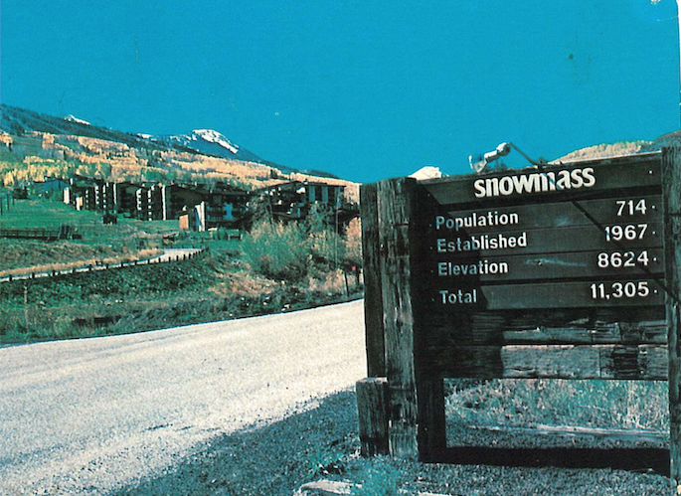
Notes:
This photo, from a postcard, makes the point nicely.
Pause for reading - and, perhaps, laughter
What does the Total mean? Absolutely nothing. It's adding a number to a date to a height
Back to our problem.

Slide 11
Airplane Turn-round
Between landing and taking off, the following jobs need to be done.
How much time is needed to get all of the jobs done?
 | Job | Time needed
A | Get passengers out of the cabin and off the plane | 10 minutes
B | Clean the cabin | 20 minutes
C | Refuel the plane | 40 minutes
D | Unload the baggage from the cargo hold | 25 minutes
E | Get new passengers on the plane | 25 minutes
F | Load the baggage into the cargo hold | 35 minutes
G | Do a final safety check before lift-off | 5 minutes
Notes:
In solving real problems the context of the problem is important.
If students start by just adding up the numbers, the teacher will need to get a discussion going, asking
“Can you find a way to do it in a shorter time?”
You might like to try. Talk with your neighbor about how you might approach solving it.
Allow time (5-10 minutes) for discussion in pairs, circulate, then bring everyone together to discuss.
Ask specific people an open question:
Well, has your group worked out a shorter time?
If they give a number, ask: Tell us how you got that? How about your group? What did you get?
So taking the context seriously pushes students to think about different ways to represent the problem,
and to compare alternative solutions.
Of course, they still have to add up correctly.
D+F+G is the longest sequence: 65 mins. Passenger changeover A+B+E+G is quicker: 60 mins. Refuelling can go at the same time. .

Slide 12
Mathematical Practices Standards
Make sense of complex problems and persevere in solving them.
Reason abstractly and quantitatively
Construct viable arguments and critique the reasoning of others.
Model with mathematics.
Use appropriate tools strategically.
Attend to precision
Look for and make use of structure
Look for and express regularity in repeated reasoning.
Notes:
It is the “shorter time” question that brings in a wider range of skills than one finds on a traditional ‘adding’ worksheet.
What students are doing here are the “mathematical practices". Notice that all those in red are important in what you have just done.
In addition to mathematics skills and procedures, students doing this task would engage in reasoning, modeling, sharing and supporting their ideas, constructing arguments and critiquing the reasoning of others.
[Option, if the group is really engaged with the problem :
To further these practices, a classroom lesson would not end at this point. Instead, other questions might be posed, such as “If the airline wants to speed up turnaround, where are the bottlenecks? Where should they put more resources in to speed up the whole process?”
Allow a few minutes for pairs to discuss this - Put more resources into baggage turnaround.]
When curriculum and teachers increase the demand of a task in this way, it changes “regular” exercises into
what some educators call “Expert Tasks”.
That is, substantial tasks in a form they might arise in the real world - or indeed within mathematics.

Slide 13
Doing Math - Overview
Proficient students expect mathematics to make sense.
They take an active stance in solving mathematical problems.
When faced with a non-routine problem, they have the courage to plunge in and try something, and
They have the procedural and conceptual tools to carry through.
They are experimenters and inventors, and can adapt known strategies to new problems.
They think strategically
(From a draft of CCSSM)
Notes:
The point the last set of slides was making is nicely summarized in this slide - from a draft of the Standards.
Read this slide.
Discuss with your neighbor:
What things on this list align with what you want your student to be able to do?
Which of them were part of the math you got at school?

Slide 14
Key capabilities
What are they?
Notes:
Seeking parents’ priorities (5 minutes starting at ~25 minutes)
Now let’s look from a different viewpoint, broader than just math.

Slide 15
Key Capabilities
What capabilities in general do you want your children to leave school with?
Let’s look from a broader viewpoint, beyond just math.
Talk with your neighbors, try to agree on your priorities, and write them down.
Notes:
What capabilities in general do you want your children to leave school with?
Talk with you neighbors, try to agree on your priorities, and write them down.
Use Handout 3.
When the groups look to have finished, collect their top priorities from various groups.

Slide 16
Key Capabilities
Notes:
Optional: Escape from “slideshow” and list the responses on Slide 13 - or use a flipchart. Otherwise just collect and discuss their priorities.
With most groups, the top priorities will be capabilities like:
Co-operative, works well with others
Self-confidence
Tackles challenges sensibly
It is rare for math skills to be near the top of the list. . If that is what emerges, point it out

Slide 17
Key Capabilities
How much did your school mathematics program contribute to building these key capabilities?
How might these the “mathematical practices” in the Common Core Standards for Mathematics change that?
Notes:
How much did your school math contribute to building these capabilities?
Probably not much!
Improving on this is a key goal of the Standards.

Slide 18
What do the Standards mean for a District’s Program?
Implementing the Standards for Mathematics has meant
Moving some curriculum
Broadening and refocusing instruction
A greater focus on content coherence
It has also meant
Daily involvement by students with the practices
Assessments that assess concepts, procedures, reasoning and problem solving
Notes:
Read the slide
So what does this mean for your district’s math program?
Coherence. A program of curriculum, instruction and assessment that is focused, logical, with a clearly articulated set of concepts
that develop over time in which understanding the ideas is central to knowing the mathematics. (CCSS, 2010; PSSM, 2000)
Balance. A program where both conceptual understanding and procedural fluency are developed and
the development of both are closely linked to
the practices involved in “doing mathematics, notably constructing and critiquing reasoning and solving non-routine problems

Slide 19
Concepts and Skills
support each other
Notes:
Concepts in the Math Standards (15 minutes starting at 30 minutes)
We’ve looked at an example of a student task aligned with the Standards and that engages students in problem solving.
Now we want to engage you in an experience that involves developing students’ concepts and skills.
The tasks that follow not only represent the learning expectations of the Standards but also research on effective teaching and learning.

Slide 20
Concept
focused math
Problem solving
focused math
Mathematical topic
Problem
Illustrative
Applications
Choose appropriate
mathematical tools
Notes:
There are two different kinds of mathematical activities that children need to be involved in when studying mathematics.
Concept and Skill focused: Building a mathematical toolkit consisting of computational math skills and understanding of math concepts
Problem-solving focused: Learning to use your mathematical toolkit
Students need both.

Slide 21
Tasks for Concept Development and Reinforcement
Classifying, naming and defining objects
Interpreting multiple representations
what is another way of showing this?
Analyzing and testing generalizations
Exploring structure and connections
Notes:
In developing students understanding of mathematical concepts, it is important that they engage in a variety of genres – types of learning activity.
Read the genres
Just as in Language Arts it is important that students read and study multiple genres, multiple authors; so is it in mathematics.
Multiple math genres contribute to students’ understanding of mathematical ideas. We only have time to look briefly at two.
The first involves graphs, but takes it to a different and more rigorous level then some of you might remember or have experienced.

Slide 22
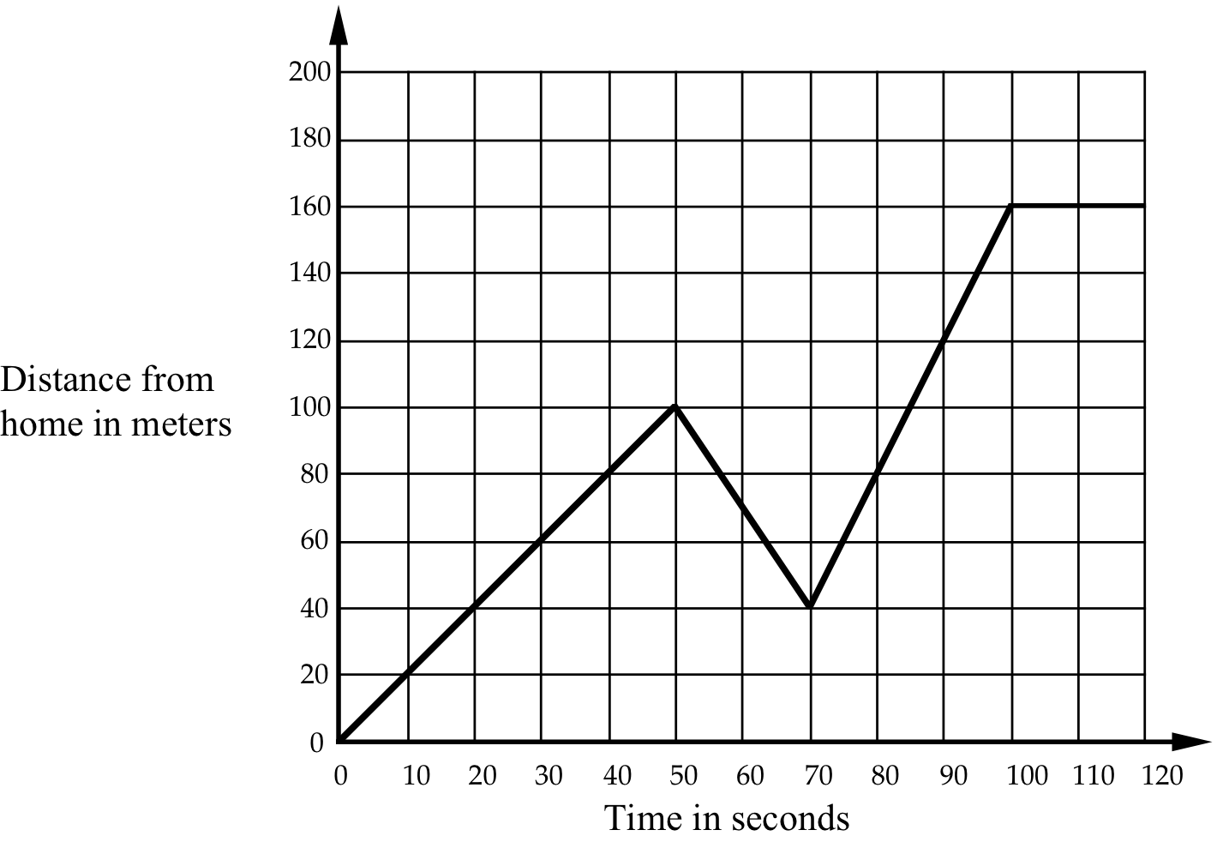
Multiple representations: Distance-time graphs
Every morning Jane walks along a straight road to a bus stop 160 meters from her home, where she catches a bus to college. The graph shows her journey on one particular day. Describe what may have happened. Is the graph realistic? Why?
Notes:
Interpreting multiple representations:A Graphs task (15 minutes starting at 35 minutes)
Graphs play a big role in presenting information about the world.
They are a powerful mathematical representation with all kinds of uses. It is important to understand what story a graph tells.
Let’s take a look at a lesson that is designed to help students understand graphs.
Think a moment about what this graph represents. Notice the axes are time and distance from home.
What do you think Jane might be doing?
Read the text slowly.
Be sensitive to parents who may misinterpret the graph.
Students often confuse graphs with pictures. In the beginning of studying graphs it is not uncommon for students to say things like: “Jane goes uphill, then downhill, then uphill again”. Or they say: Jane speeds up, slows down, then speeds up again” thinking that the graph is about speed instead of distance.
It takes time, discussions and multiple experiences to help students understand what 'story' graphs like this are telling.
A reasonable story?
"Jane leaves home, walking to the bus stop. After about a minute, she sees her friend behind her and walks back to meet her. They then realize they might miss the bus so run together and reach the stop with time to spare."
(or realises she has dropped something)
Numbers optional in a story like that. Faster speed on the third steeper part of the graph is important

Slide 23
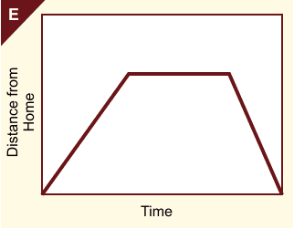
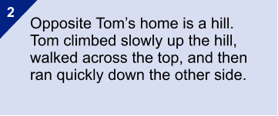
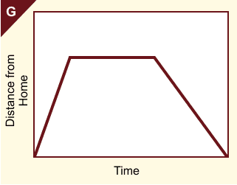
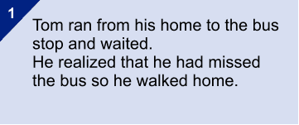
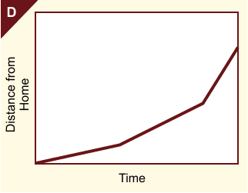
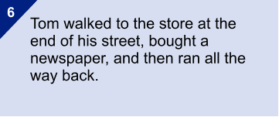
Ambiguity promotes discussion.
E.g. Can the distance from home be constant, yet Tom still be moving?
Notes:
To help students develop the depth of understanding of graphs, in the full lesson students are then given ten graphs and verbal descriptions to match.
Handout 5. has just three of them.
Talk with your neighbors to work out how to match each of these graphs to one of the stories.
Give participants time to discuss this in pairs.
Ask but don’t expect an answer; instead talk about how this is done to make students think about the graph representation and what it means.
Notice that horizontal lines do not always mean that he’s stopped. Why not?

Slide 24
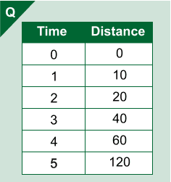
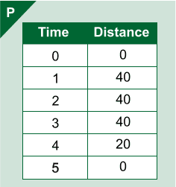
Notes:
This activity is more challenging mathematically. Judge whether the group are confident enough to tackle it. Otherwise just read below and move on.
After students have matched graphs and stories, they are given tables, containing data for each situation, to match up, as in Handout 6.
You need to match all three: Graph to word, words to table, table to graph.
How does the table show running? Walking?
How does the graph show this?
Tables provoke a different way of seeing things – a different representation.
Teachers notice how adding the tables pushes students’ thinking and that they often see students changing matches for the graphs and stories because of the tables.
This task exemplifies the genre “Interpreting Multiple Representations”. It addresses conceptual understanding and procedural fluency, as well as reasoning and making connections within mathematics.
Optional break out
If you have time and a group that wants more engagement with the mathematics, use one or both of the following MIN tools:
Parents meeting: Graphs extension
Parents meeting: Percents extension
These are exceptionally rich, and normally engaging, learning activities. Each takes at least 40 minutes

Slide 25
Building connections is crucial
“Knowledge, learning, understanding are not linear. They are not little bits of facts lined up in rows or piled up one on top of the other. A field of knowledge (such as mathematics) is a territory, and knowing it is not just a matter of knowing all the items in the territory, but of knowing how they relate to, compare with, and fit in with each other.
It is the difference between knowing the names of all the streets in a city and being able to get from any place, by any desired route, to any other place.”
“How Children Fail” John Holt Pelican Books 1984
Notes:
Broadening and deepening the mathematics curriculum by including tasks like that just presented, is what knowing and learning mathematics is about. And, although this may seem like a new idea, this broader vision of mathematics has been articulated by leading educators for some time.
This quote underlines the difference between learning facts and procedures and learning for understanding.
It is rather like the difference between using a GPS and using a map.
The Standards are about learning for understanding, which develops facts and procedures.

Slide 26
Tasks for Concept Development and Reinforcement
Tasks for Concept development and reinforcement
Classifying, naming and defining objects
Interpreting multiple representations
Analyzing and testing generalizations
“always, sometimes or never true?”
Exploring structure and connections
Notes:
Analyzing and testing generalizations (10 minutes after ~50 minutes)
We’ll now look at one more genre of activity:
“Analyzing and testing generalizations”

Slide 27
Always, Sometimes or Never true?
Always, sometimes or never true?
When you cut a piece off a shape you reduce its area and perimeter.
Notes:
27
27
These tasks involve students evaluating a set of mathematical statements and deciding if and when they are true (or not). Tasks of this nature deepen students understanding of mathematical concepts.
The statements used are ones often made by students. Here’s an example.
Read the statement slowly
What do you think?
Is it always, sometimes or never true?
If it is sometimes true, can you say when it is true?

Slide 28
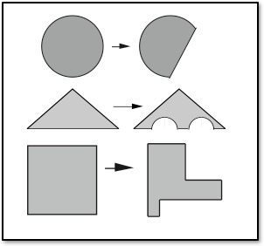
Always, Sometimes or Never true?
Always, sometimes or never true?
When you cut a piece off a shape you reduce its area and perimeter.
Notes:
28
28
Working with this genre can be challenging for students. Sometimes, when students are struggling to make sense of such statements,
a task may offer students a few examples to consider, to push their ideas and thinking of the statement and the mathematics.
Handout 7 gives some more examples you might like to think about later.
Note the set of drawings that accompany this statement.
How do the drawings help you think about the task and the mathematics? Did you change your answer after looking at the drawings? Why?
Ask - but it is not needed that you have participants answer these questions in a whole group discussion. You may suggest they talk to somewhat near them about how the drawings affected their thinking.

Slide 29
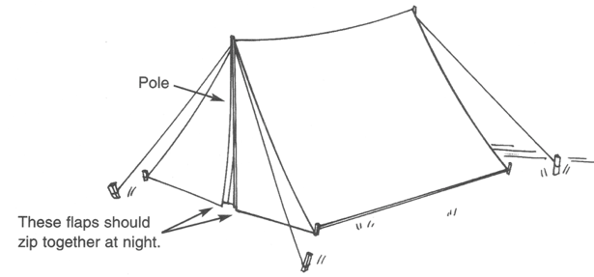
Concepts and Skills
support
Problem Solving
Notes:
Concepts and skills support problem solving (5 minutes after 60 minutes)
Let's see how concepts and skills support problem solving in another example.

Slide 30
Students must select the mathematics
Show how to cut the material to make a tent like this that is big enough for two adults to sleep in.
Show all your measurements clearly.
Notes:
The Standards mean we need to include real-world problems that involve students in making decisions about the mathematics they use.
We usually call these modeling problems.
They are often poorly defined, just like most real world problems are, and require the student to make assumptions.
Here is just one example.
Read the task on the slide.
Students need to estimate the size of an adult,
then sketch the shape of the material for the tent.
They must then estimate and calculate measurements so they can cut the material.
Lets look at one student’s solution:

Slide 31
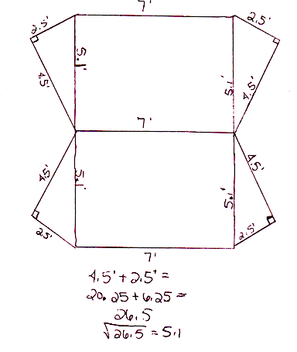
This student has chosen Pythagoras
Notes:
Notice this student's assumptions, that:
• 4.5 feet high enough for the tent,
• 5 feet is wide enough
• 7 feet is long enough.
She has then had to visualize the shape of the material for cutting. This is quite difficult!
The student has also chosen to use the Pythagorean theorem to calculate the slanted edge of the tent. (5.1 feet).
This is a measurement needed for cutting it.
In most math lessons students are told the math to use. It is rare to see them choosing it!
But this is what is needed if theyare to use math powerfully to tackle problems in the real world.

Slide 32
Summary
Notes:
Summary (5 minutes after 65 minutes)

Slide 33
The Standards: math lessons that teach students to
Make sense of complex problems and persevere in solving them.
Reason abstractly and quantitatively.
Construct viable arguments and critique the reasoning of others.
Model with mathematics.
Use appropriate tools strategically.
Attend to precision.
Look for and make use of structure.
Look for and express regularity in repeated reasoning.
…..and so they contribute to building key capabilities
Notes:
This slide summarizes the objectives of the Standards.
We have tried to illustrate most of these points in this workshop.
Of course, there is more.

Slide 34
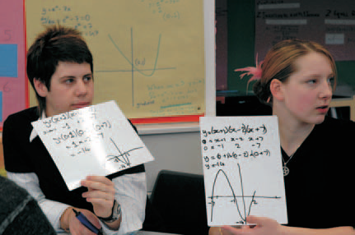
Improving the flow of information
Improving the flow of information
Notes:
Good instruction practices are critical to implementation of the Standards
Good teaching depends on knowing where your students are and responding appropriately.
In math classrooms, teachers should encourage students to discuss their ideas, much as you have been doing.
In other good strategies:
• students record their ideas on mini-whiteboards for sharing with each other and the teacher,
who can quickly get an idea of where students are in their thinking
• students work together to produce posters that display their reasoning.
Then the teacher can walk around the room and listen and take note of student thinking, without interrupting student discussions.
We’ll see an example of this in a moment.
Research shows us that by articulating their ideas openly, in words, pictures, and symbols students develop a much better understanding of the content.

Slide 35
Now for your
Questions
Notes:
Time for Questions (10 or more minutes after 65 minutes)
Allow plenty of time for this.
Now is the chance to use the responses you have prepared.

Slide 36
Thank you
<your contact email>
Notes:
Thank you
Customize this slide with your own contact details.

