Slide 1
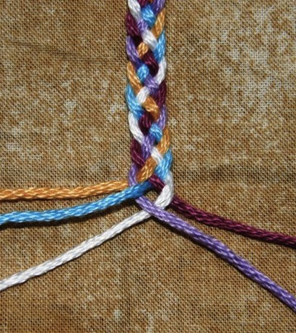
Developing Mathematical Proficiency
The potential of different types of tasks for student learning
Notes:
March 2017 Release
Title Slide
You may like to customize this slide and/or the last one with your own institutional and contact details. Please leave the copyright attribution, however.
Possible comments below are in plain text. Suggestions are in italics. Users will, of course, adapt as necessary – though we recommend sticking with this activity sequence the first time or two.
Today’s workshop is about exploring what it means to develop mathematical proficiency, identifying tasks that encourage the different elements that make up the characteristic behaviors of a mathematically proficient student.
Copying
Except where noted/credited otherwise, these materials are Copyright © 2015-2017 Mathematics Assessment Resource Service, University of Nottingham. They are published under the Creative Commons Attribution-NonCommercial-ShareAlike 4.0 International license, so they may be copied and adapted for non-commercial use under certain conditions and with appropriate attribution. Please see the license for details, or contact us via http://mathnic.mathshell.org/contact.html if in doubt.
All MathNIC materials can be freely downloaded from our website http://mathnic.mathshell.org/

Slide 2
Workshop Outline
The Five Strands of Mathematical Proficiency
  Conceptual Understanding
  Procedural Fluency
  Strategic Competence
  Adaptive Reasoning
  Productive Disposition
Introducing the Tasks
Working on the Tasks
Feedback on the Tasks
Reflection
Notes:
Workshop Outline
Here is an outline of what we are going to work through today, as we look at the potential of different types of tasks for student learning:
Rough timing
The Five Strands of Mathematical Proficiency: (25 mins)
- Conceptual Understanding
- Procedural Fluency
- Strategic Competence
- Adaptive Reasoning
- Productive Disposition
Introducing the Tasks (5 mins)
Working on the Tasks (30 mins)
Feedback on the Tasks (20 mins)
Reflection (10 mins)

Slide 3
The Five Strands of Mathematical Proficiency
Notes:
The Five Strands of Mathematical Proficiency (25 minutes)
In 2001, the National Research Council, in their report Adding it up: Helping children learn mathematics, sought address a concern expressed by many Americans: that too few students in our schools are successfully acquiring the mathematical knowledge, skill, and confidence they need to use the mathematics they have learned.
Using the term ‘mathematical proficiency’ to describe what it means to learn mathematics successfully, they identified the five strands which we are going to look at …

Slide 4
Five Strands of Mathematical Proficiency
Conceptual Understanding
Procedural Fluency
Strategic Competence
Adaptive Reasoning
Productive Disposition
Kilpatrick, Swafford, & Findell. (2001) – Adding It Up (p.116)
Notes:
The five strands are interwoven and interdependent in the development of proficiency in mathematics and include:
Conceptual Understanding - the comprehension of mathematical concepts, operations, and relations
Procedural Fluency - skill in carrying out procedures flexibly, accurately, efficiently, and appropriately
Strategic Competence - the ability to formulate, represent, and solve mathematical problems
Adaptive Reasoning – the capacity for logical thought, reflection, explanation, and justification
Productive Disposition – the habitual inclination to see mathematics as sensible, useful, and worthwhile, coupled with a belief in diligence and one’s own efficacy.
Let's now look at each of the five strands in a bit more detail …

Slide 5
Developing the Five Strands
Conceptual Understanding | Enables students to connect ideas to what they already know Supports retention and prevents common errors
Procedural Fluency | Learning procedures can strengthen and develop mathematical understanding, while understanding makes it easier to learn skills
Strategic Competence | To come up with answer to a problem, students must: follow a solution method and adapt as necessary understand the quantities in the problem and their relationships represent the relationships mathematically have the mathematical skills required to solve the problem
Adaptive Reasoning | As students reason about a problem they can: build their understanding carry out the needed computations apply their knowledge explain their reasoning to others
Productive Disposition | Requires frequent opportunities to: make sense of mathematics recognize the benefits of perseverance experience the rewards of sense making in mathematics
Notes:
Direct participants’ attention to Handout 1, which provides a summary of the five strands.
Conceptual Understanding
Students with conceptual understanding know more than isolated facts and methods. They organize their knowledge into a coherent whole, enabling them to learn new ideas by connecting them to what they already know. Because facts and methods learned with understanding are connected, they are easier to remember and use, and can be reconstructed when forgotten. If students understand a method, they are more likely to remember it correctly.
Procedural Fluency refers to knowledge of procedures, of when and how to use them, and skill in performing them. Without sufficient procedural fluency, students have trouble deepening their understanding of mathematical ideas or solving mathematics problems.
Strategic Competence refers to the ability to formulate mathematical problems, represent, and solve them. A student with strategic competence can not only come up with several approaches to a non-routine problem, but also choose flexibly among different methods to suit the demands of the problem and the situation in which it is posed.
Adaptive Reasoning refers to the capacity to think logically about the relationships among concepts and situations.
Productive Disposition refers to the tendency to see sense in mathematics, perceive it as both useful and worthwhile, believe that steady effort in learning mathematics pays off, and see oneself as an effective learner and doer of mathematics. .
Adapted from: https://mathequality.wordpress.com/2012/06/25/nrcs-five-strands-of-mathematical-proficiency/

Slide 6
Conceptual
Understanding
Notes:
Conceptual Understanding
Let’s now take a closer look at what it means for students to develop their conceptual understanding of mathematics and
why it’s important for us to encourage its development in our classrooms.

Slide 7
Conceptual Understanding
“Conceptual understanding frequently results in students having less to learn because they can see the deeper similarities between superficially unrelated situations.
Their understanding has been encapsulated into compact clusters of interrelated facts and principles.”
Kilpatrick, Swafford, & Findell. (2001) – Adding It Up (p.120)
Notes:
We can often find that our desire to ‘cover’ the curriculum results in us limiting the time we give to providing opportunities for students to develop their conceptual understanding.
Conceptual understanding allows a student to apply and adapt acquired mathematical ideas to new situations, which means that they have less to learn, as they are able to relate new knowledge to what they already know.
With this in mind, the benefits of selecting tasks that encourage the development of conceptual understanding can be clearly seen.

Slide 8
Levels of Conceptual Understanding
Adapted from: https://mathequality.wordpress.com/2012/06/25/nrcs-five-strands-of-mathematical-proficiency/
Notes:
The development of conceptual understanding comes through the exploration of the meaning of things, rather than repeated practice.
1. Factual Knowledge The development of conceptual understanding begins with students knowing facts and being able to recollect this information at the appropriate times.
2. Comprehension As students move beyond the ability to merely recall facts, they begin to demonstrate a comprehension of mathematical concepts as they develop their knowledge of what mathematical procedures mean.
3. Application Students are able to apply and adapt the mathematical ideas they have acquired, to new situations.
4. Analysis The degree to which students have developed conceptual understanding is related to the richness and extent of the connections they make as they explore and analyze mathematical structures.
5. Synthesis A significant indicator of conceptual understanding is being able to represent mathematical situations in different ways, and knowing how different representations can be useful for different purposes.
6. Evaluation When students have acquired conceptual understanding in an area of mathematics, they see the connections among concepts and procedures, and can give arguments to justify why some facts are consequences of others.
Students who are taught for understanding are likely to be more engaged with what they are learning, as they begin to grasp how the mathematical ideas they experience fit together to form an interrelated landscape of concepts.

Slide 9
Procedural
Fluency
Notes:
Procedural Fluency
Let’s now move on to the second strand.
While the knowledge of procedures builds on the foundation of conceptual knowledge, procedural fluency is important in its own right.
Let’s take a closer look …

Slide 10
Procedural Fluency
“Business and political leaders are asking schools to ensure that students leave high school 'college and career ready,' possessing 21st Century competencies that will prepare them for adult roles as citizens, employees, managers, parents, volunteers, and entrepreneurs. Using mathematics effectively to solve real-world problems is a critical component of those competencies, and, consequently, is a strong emphasis in the Common Core State Standards for Mathematics and other high-quality standards. Developing procedural fluency is a critical part of instruction to ensure that students are adequately prepared for their futures.”
NCTM President Diane Briars (2014) Students Need Procedural Fluency in Mathematics
Notes:
Procedural fluency is a critical component of mathematical proficiency.
When developing procedural fluency, students need to have a deep and flexible knowledge of a variety of procedures, along with the ability to judge which procedures or strategies are appropriate for use in particular situations.
The end goal is that students are able to use appropriate mathematical procedures fluently, to apply their understanding to real world problems.

Slide 11
Procedural Fluency
The ability to apply appropriate procedures:
Accurately - reliably producing the correct answer
Efficiently – carrying out procedures easily, keeping track of sub-problems, and making use of intermediate results to solve a problem
Flexibly - knowing more than one approach, choosing an appropriate strategy, and using one method to solve and another method to double-check
Briars (2016) NCSM Supporting Teachers in Building Procedural Fluency from Conceptual Understanding
Notes:
The NCTM defines procedural fluency as the ability to apply procedures accurately, efficiently, and flexibly. Procedural fluency and conceptual understanding often compete for attention in the classroom, however the two strands are interwoven.
When students practice procedures they don’t understand, there’s a danger they will practice incorrect procedures, resulting in them failing to produce a correct answer to a problem. Students who learn procedures without understanding typically do no more than apply the learned methods, whereas students who learn with understanding, can modify or adapt procedures to make them easier to use. Students, therefore, need well-timed skills practice to support their development of the other strands.

Slide 12
Strategic Competence
When faced with a mathematical problem students who are strategically competent have the ability to:
Formulate
Identify accessible questions
Make simplifying assumptions
Identify significant variables and generate relationships between them
Represent
Represent the situation mathematically, selecting appropriate mathematical concepts and procedures
Solve
Monitor progress in a solution approach, changing direction as needed
Interpret and evaluate results in the context of the problem
Explain why a conclusion does or doesn’t make sense
Notes:
Strategic Competence refers to the ability to formulate mathematical problems, represent and solve them. This process involves taking a situation and turning it into a solvable problem that can be represented by a mathematical model, employing mathematical skills to produce a solution, and then interpreting and evaluating the solution in the context of the problem.

Slide 13
Strategic
Competence
Notes:
Strategic Competence
Let’s now move on to the third strand – Strategic Competence …

Slide 14
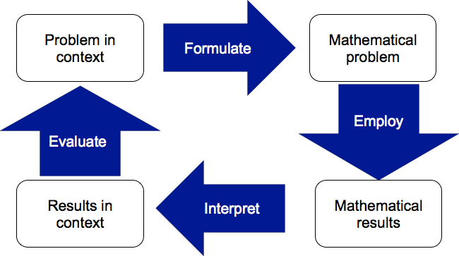
Students as Active Problem Solvers
Reproduced from https://www.oecd.org/pisa/pisaproducts/Draft%20PISA%202015%20Mathematics%20Framework%20.pdf
Notes:
When addressing the question of what competency means in mathematics, the PISA 2015 mathematical framework identifies the importance of young people emerging from school, being adequately prepared to apply mathematics to solving meaningful problems.
The flowchart shows a simplified version of the stages through which a problem solver moves, with each process drawing on fundamental mathematical capabilities.

Slide 15
Relationship Between the Strands
Strategic Competence
Provides a context for developing conceptual understanding
Depends on conceptual understanding and procedural fluency
Procedural Fluency
Develops as strategic competence is used to select procedures
Conceptual Understanding
Develops as new skills are acquired through increased competence at devising strategies for solving problems
Notes:
There is a mutually supportive relationship between strategic competence and both conceptual understanding and procedural fluency.
Developing competence in solving non-routine problems provides a context and motivation for learning to solve routine problems. Similarly, the development of strategies for solving non-routine problems depends on understanding the quantities involved and their relationships, and fluency in solving routine problems.
Students develop procedural fluency as they use strategic competence to choose effective procedures. They learn that solving challenging problems depends on carrying out procedures readily and that problem solving helps them acquire new concepts and skills.
Research shows that very young children use a variety of strategies to solve problems, selecting strategies well suited to particular problems, showing the beginnings of adaptive reasoning, the next strand to be discussed.

Slide 16
Adaptive
Reasoning
Notes:
Adaptive Reasoning
Adaptive Reasoning refers to the capacity for logical thought, reflection, explanation, and justification.
Let’s take a look at how students can demonstrate this strand and how it relates to the strands we have already explored.

Slide 17
Adaptive Reasoning
“One hallmark of mathematical understanding is the ability to justify, in a way appropriate to the student’s mathematical maturity, why a particular mathematical statement is true or where a mathematical rule comes from.”
(Common Core Standards, page 4)
Notes:
In mathematics, adaptive reasoning guides learning as students navigate through facts, procedures, concepts, and solution methods to see if they fit together in a way that makes sense. A demonstration of adaptive reasoning is students’ ability to justify their work.

Slide 18
Relating the Strands
Adaptive reasoning interacts with the other mathematical proficiency strands
Conceptual understanding provides representations that can serve as a source of adaptive reasoning
Solution strategies require procedural fluency and adaptive reasoning is used to determine the appropriateness of procedures
Strategic competence is used to monitor progress toward a solution and and to generate alternative plans as necessary
Notes:
Adaptive reasoning interacts with the other strands of proficiency, particularly during problem solving. Students draw on their strategic competence to formulate and represent a problem, using investigative approaches that may provide a solution strategy, but adaptive reasoning must take over when they are determining the validity of a proposed strategy.
Conceptual understanding provides representations that can serve as a source of adaptive reasoning, which, taking into account the limitations of the representations, students use to determine whether a solution is justifiable and then to justify it.
Often a solution strategy will require fluent use of procedures, but adaptive reasoning should be used to determine whether the procedure is appropriate.
While carrying out a solution plan, students use their strategic competence to monitor their progress toward a solution and to generate alternative plans, if the current plan seems ineffective.

Slide 19
Productive
Disposition
Notes:
Productive Disposition
Let’s now look at the final strand, productive disposition …

Slide 20
Productive Disposition
A productive disposition develops with the other strands, helping each of them to develop.
Students’ disposition toward mathematics is a major factor in determining their educational success.
Students who have developed a productive disposition are confident in their knowledge and ability.
Notes:
As the other strands develop, so too does productive disposition. For example, as students’ strategic competence is developed as they solve non-routine problems, their belief in themselves as mathematics learners become more positive. Similarly, when students see themselves as capable of learning mathematics and using it to solve problems, they become able to develop further their procedural fluency and adaptive reasoning abilities.

Slide 21
Introducing the Tasks
Notes:
Introducing the Tasks (5 minutes, starting after 25 minutes)
We are now going to split into groups, with each group looking at one of four tasks that I will now briefly introduce.
We will consider which of the five strands of mathematical proficiency each task helps students to develop.
We’ll share our findings later in the session.
Let’s have a look at the tasks and then we can suggest which task each group should look at.

Slide 22
Task A: Percent Change Game
Use these 12 numbers to fill in the gaps below.
10, 20, 25, 35, 40, 50, 60, 70, 75, 80, 90, 100
$____ increased by ____% = $____
$____ increased by ____% = $____
$____ decreased by ____% = $____
$____ decreased by ____% = $____
You score a point for each number used only once – and in a correct expression. (Maximum score: 12 points)
Adapted from http://www.foster77.co.uk/Percentage%20Change%20TASK%20SHEET.pdf
Notes:
Direct participants’ attention to Handout 2.
Here is the first task, Task A:
In this game, students are invited to complete four statements using the given numbers so that the statements are mathematically correct.
They score one point for each number that is used only once, and in a correct expression
(Numbers used more than once don’t score.)

Slide 23
Task B: Describing and Defining a Square
Four equal sides
Diagonals meet at right angles
Two pairs of parallel sides
4 lines of symmetry
Rotational symmetry of order 4
Two equal diagonals
Four right angles
Which pairs of statements define a square?
Which pairs do not?
A lesson called ‘Describing and Defining Quadrilaterals’ based on this task, can be found on the Mathematics Assessment Project website (http://map.mathshell.org/)
Notes:
Direct participants’ attention to Handout 3.
Task B invites students to use the properties of a square to identify pairs of property descriptions that, without any further information, define a square. When using this task in the classroom, it can be adapted and extended in the following ways:
Asking students to provide the properties of a square themselves, rather than giving them this information.
Starting with just one statement and asking students to determine if that statement defines the square and if not, what other shapes it could be describing. Once some, or all of the statements have been explored individually, the task can then be extended to look at pairs of statements. (And may then be extended to looking at more than two statements at a time).
Extending to consider other shapes.
For those of you working on this task, you may wish to consider some of these adaptations as part of your familiarization with the task.

Slide 24
Task C: Always, Sometimes or Never True?
If you add the same number to the top and bottom of a fraction, the fraction increases in value.
If you divide the top and bottom of a fraction by the same number, the fraction gets smaller in value.
If you multiply 12 by a number, the answer will be greater than 12.
If you divide 12 by a number, the answer will be less than 12.
Prices increased by 20%.
They then decreased by 20%.
There was no overall change in prices.
Jill got a pay rise of 3%.
James got a pay rise of 2%.
Jill therefore got the greater pay rise.
Notes:
Direct participants’ attention to Handout 4.
Task C contains a collection of six mathematical statements or conjectures. Students are invited to consider each statement in turn and decide whether it is always, sometimes or never true.
If it is always true, they need to show some examples, and try to provide an explanation as to why it is true.
If it is never true, they need to explain why.
If it is sometimes true, they need to give examples, and then to define precisely when it is true and when it is not true.

Slide 25
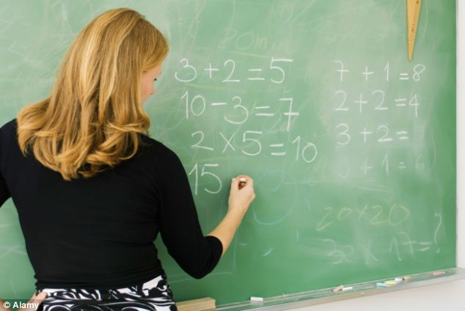

Task D: Schoolteachers and Dentists
There are about 320 million people in the US.
About how many school
teachers are there?
Estimate some other facts and check them out.
About how many dentists are there?
Adapted from http://www.bowlandmaths.org.uk/pd/pd_01.html
Notes:
Direct participants’ attention to Handout 5.
Task D offers an unstructured estimation problem. Students are invited to estimate the number of school teachers/dentists in the US, having been given information only on the country’s population.
Using what they know and making assumptions for what they don’t know, students need to come up with an estimate that they can both explain and justify.

Slide 26
Working on the Tasks
Notes:
Working on the Tasks (30 minutes, starting after 30 minutes)
This section involves first individual work on a task, then discussion in small groups, before sharing later.
Before we can begin working on the tasks, we need to form groups. So please do that: 3 to 5 per group is good.
I'll then suggest one of the tasks for each group to look at - first individually then as a group.
We'll all share later.

Slide 27
Working on the Tasks
On your own, have a go at the task.
Discuss in your groups which of the five strands of mathematical proficiency you think your task could support, and how.
Consider ways in which the task might be modified to address the other strands that it doesn’t currently support.
Elect someone in your group to be the spokesperson for presenting your ideas to the rest of the group.
Notes:
Describe to participants how they will work on the task. They may wish to use the mini-whiteboards and dry-erase markers provided as they do this:
Spend 10 - 15 minutes familiarizing yourself with the task and working through it. As you work on the task, consider which of the five strands the task could support. (They’re on Handout 1.)
When you have had sufficient individual think time, move into your group and discuss with the others, whether or not you agree on which of the mathematical proficiency strands the task could support, considering ways in which the task does this.
You may also want to consider how the task could be modified to address the strands that you don’t feel it currently supports.
As you draw your discussion to an end, elect a member of the group to be the main spokesperson to present your ideas to the rest of the group. Other members of the group may want to comment as well, but it would be good to choose someone who will begin the presentation of the group’s ideas.

Slide 28
Feedback on the Tasks
Notes:
Feedback on the Tasks (20 minutes, starting after 60 minutes)
Bring everyone together and orchestrate a discussion of the four tasks, giving participants the opportunity to share their thoughts on the task they have studied.
We will now have a look at the four tasks in turn, with each group having the opportunity to share their insights into their task explaining which mathematical proficiency strands they think the task could support and why.
Of course, all five strands are involved with most worthwhile tasks but each of these four has a rather different proficiency focus.

Slide 29
Task A: Percent Change Game
Use these 12 numbers to fill in the gaps below.
10, 20, 25, 35, 40, 50, 60, 70, 75, 80, 90, 100
$____ increased by ____% = $____
$____ increased by ____% = $____
$____ decreased by ____% = $____
$____ decreased by ____% = $____
You score a point for each number used only once – and in a correct expression. (Maximum score: 12 points)
Adapted from http://www.foster77.co.uk/Percentage%20Change%20TASK%20SHEET.pdf
Notes:
It is important to allow each group to feedback on the tasks, before adding any further details about the thinking behind a task’s design.
Based on the feedback received from participants, it may not be necessary to use all or some of the content of the slides that follow.
Feel free to use them as appropriate, depending on how the discussion of each task goes.
Begin by asking the group(s) that worked on Task A to provide their feedback …

Slide 30
Task A: Percent Change Game
Use these 12 numbers to fill in the gaps below.
10, 20, 25, 35, 40, 50, 60, 70, 75, 80, 90, 100
$____ increased by ____% = $____
$____ increased by ____% = $____
$____ decreased by ____% = $____
$____ decreased by ____% = $____
You score a point for each number used only once – and in a correct expression. (Maximum score: 12 points)
Adapted from http://www.foster77.co.uk/Percentage%20Change%20TASK%20SHEET.pdf
Notes:
(Optional Slide)
Task A attempts to address the mathematical proficiency strand of procedural fluency, by providing students with an opportunity to practice the technique of increasing and decreasing by a percent.
Much of the mathematics teaching we see in our classrooms is about students practicing mathematical techniques. By repeated practice it is hoped that students become fluent, so that they no longer have to focus on their technical performance. However, repeated practice often leads to boredom.
So this task has been designed to allow students to practice a mathematical skill whilst completing a non-routine task that, having a problem solving aspect as well, is both worthwhile and interesting. As fluency develops, more attention can be given to strategies for getting the best solution, i.e. 12 points.

Slide 31
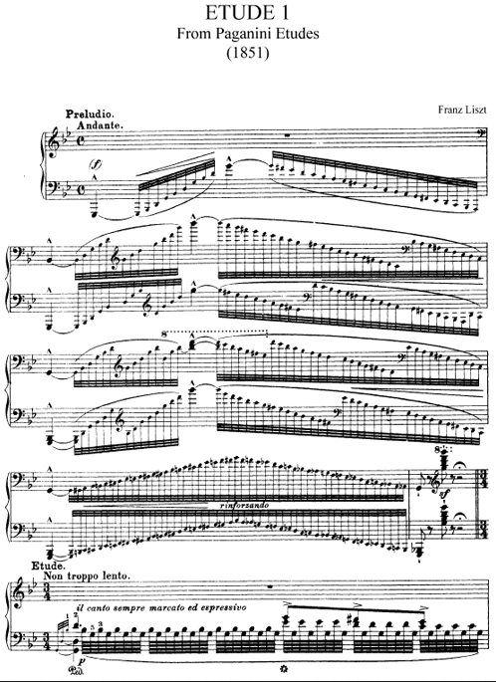
Études
Études are especially written to practice particular technical skills, but are still beautiful pieces of music in their own right.
Notes:
(Optional Slide)
Task A is an example of a mathematical étude. In musical composition, an étude is a technical exercise designed to give concentrated attention to one particular skill, while at the same time being interesting and pleasurable. Applying this metaphor to the design of mathematical tasks provides students with the opportunity to rehearse well-defined procedures through meaningful and stimulating tasks.

Slide 32
Task B: Describing and Defining a Square
Four equal sides
Diagonals meet at right angles
Two pairs of parallel sides
4 lines of symmetry
Rotational symmetry of order 4
Two equal diagonals
Four right angles
Which pairs of statements define a square?
Which pairs do not?
A lesson called ‘Describing and Defining Quadrilaterals’ based on this task, can be found on the Mathematics Assessment Project website (http://map.mathshell.org/)
Notes:
Ask the group(s) that worked on Task B to provide their feedback …

Slide 33
Task B: Describing and Defining a Square
Four equal sides
Diagonals meet at right angles
Two pairs of parallel sides
4 lines of symmetry
Rotational symmetry of order 4
Two equal diagonals
Four right angles
Which pairs of statements define a square?
Which pairs do not?
A lesson called ‘Describing and Defining Quadrilaterals’ based on this task, can be found on the Mathematics Assessment Project website (http://map.mathshell.org/)
Notes:
(Optional Slide)
Conceptual understanding comes from tasks that invite students to produce classifications, definitions, representations and explanations.
Task B supports students in developing their conceptual understanding of 2D shapes, by asking them to identify the minimal information required to define a square.
By exploring different combinations of the properties to determine which describe a square, students are able to sort the properties, identifying the key properties of 2D shapes when distinguishing them from other similar figures.
A lesson based on this task called Describing and Defining Quadrilaterals can be found on the Mathematics Assessment Project website.

Slide 34
Task C: Always, Sometimes or Never True?
If you add the same number to the top and bottom of a fraction, the fraction increases in value.
If you divide the top and bottom of a fraction by the same number, the fraction gets smaller in value.
If you multiply 12 by a number, the answer will be greater than 12.
If you divide 12 by a number, the answer will be less than 12.
Prices increased by 20%.
They then decreased by 20%.
There was no overall change in prices.
Jill got a pay rise of 3%.
James got a pay rise of 2%.
Jill therefore got the greater pay rise.
Notes:
Ask the group(s) that worked on Task C to provide their feedback …

Slide 35
Task C: Always, Sometimes or Never True?
If you add the same number to the top and bottom of a fraction, the fraction increases in value.
If you divide the top and bottom of a fraction by the same number, the fraction gets smaller in value.
If you multiply 12 by a number, the answer will be greater than 12.
If you divide 12 by a number, the answer will be less than 12.
Prices increased by 20%.
They then decreased by 20%.
There was no overall change in prices.
Jill got a pay rise of 3%.
James got a pay rise of 2%.
Jill therefore got the greater pay rise.
Notes:
(Optional Slide)
The type of activity we see in Task C encourages students to construct examples and counterexamples and look for domains of validity.
While adaptive reasoning should permeate all students’ work in mathematics, there are some specific types of task that are ideally suited to the development of mathematical conjectures and arguments.
This ‘Always, Sometimes or Never True’ task is one example.

Slide 36
Task D: Schoolteachers and Dentists
There are about 320 million people in the US.
About how many school
teachers are there?
Estimate some other facts and check them out.
About how many dentists are there?
Adapted from http://www.bowlandmaths.org.uk/pd/pd_01.html
Notes:
Ask the group(s) that worked on Task D to provide their feedback …

Slide 37
Task D: Schoolteachers and Dentists
There are about 320 million people in the US.
About how many school
teachers are there?
Estimate some other facts and check them out.
About how many dentists are there?
Adapted from http://www.bowlandmaths.org.uk/pd/pd_01.html
Notes:
(Optional Slide)
Strategic competence is developed as students tackle problems from the real world, taking an often messy, real-life situation and turning it into a solvable mathematical problem.
Students have to make assumptions to simplify the problem in order to formulate a mathematical model that can be solved.
In Task D, students are required to identify variables, generating relationships between these variables as they represent the problem mathematically in order to solve it.

Slide 38
Developing Mathematical Proficiency
Notes:
While none of the four tasks we have looked at have been explicitly identified as focusing on productive disposition, the opportunities for students to develop as effective learners and doers of mathematics can be clearly seen.
By selecting tasks that promote the mathematical proficiency strands, we can help our students to learn successfully and become confident and effective doers of mathematics.

Slide 39
Reflection
Notes:
Reflection (10 minutes)
We hope this workshop has provided you with a framework for thinking about the tasks students need to experience in order to achieve a balanced mathematics curriculum.
Let’s spend a few minutes reflecting on the tasks we already use and consider how some of the tasks we have looked at today could be used in our classrooms …

Slide 40
Reflection
Think about tasks that are already in use (either by you or well known tasks) and categorize them under the five strands of mathematical proficiency.
Which of the five strands of mathematical proficiency do students currently have the most opportunity to develop in your classroom?
How do you plan to include a balance of the mathematical proficiency strands in your curriculum over the coming weeks.
Notes:
If more than one participant has come from the same school or school district, you may want to encourage them to discuss the first part of this reflection together.
Discuss with your neighbor some familiar tasks that are currently in use today and see if you can categorize them based on the five strands of mathematical proficiency. Complete the table on the first section of Handout 6 with your ideas.
After about 5 minutes, once participants have had chance to discuss some familiar tasks, direct their focus to their current practice and to reflecting on ways to encourage a balanced curriculum of the development of students’ mathematical proficiency in their classrooms.
Now, on your own, reflect on your own practice, identifying which of the five strands of mathematical proficiency your students currently have the most opportunity to develop. Note down your thoughts at the bottom of Handout 6, including an idea of how you think you could promote a balanced curriculum of the mathematical proficiency strands over the coming weeks.

Slide 41
Thank you
< insert contact details >
Notes:
Thank you
Customize the final slide with your own contact details.

